Slide 1
Operating Remotely Via The Internet
N4GYN Remote Presents:
An All-In-One Solution
And It is FREE!
Notes:
Before you begin:
Students taking this course should be familiar with how to create and save Word documents, or take the training presentation titled, “Create your first document.”
[Note to trainer: For detailed help in customizing this template, see the very last slide. Also, look for additional lesson text in the notes pane of some slides.]

Slide 2
Introducing RemoteHams.com
Remote Control, Chat, and VOIP in One App!
No Need For Multiple Programs!
Mobile App Available!
Excellent Support!
IT’S FREE!
Best Remote Control Software since HRD

Slide 3
Basic Remote Control
Join RemoteHams.com (free)
Download RCForb Client (free)
Install & configure RCForb
Operate numerous remotes via the web
You will need a microphone connected to your computer.
A headset is desirable for best audio quality on the air.
A very good headset can be purchased for about $24.00
Best Remote Control Software since HRD

Slide 4
How Can This Help ARES?
Remote HF & VHF/UHF Communications
No radio equipment? No problem!
No computer? Use SmartPhone!
Hear & transmit outside incidence area
Many remotes available world-wide!
Can use digital modes (not via mobile)
Easy to Operate!

Slide 5
Getting Started…
Go to http://remotehams.com
Create an account
Download the apps: Client & Server
Install the apps
Run the Client (RCForb.exe)
It’s THAT Easy!

Slide 6
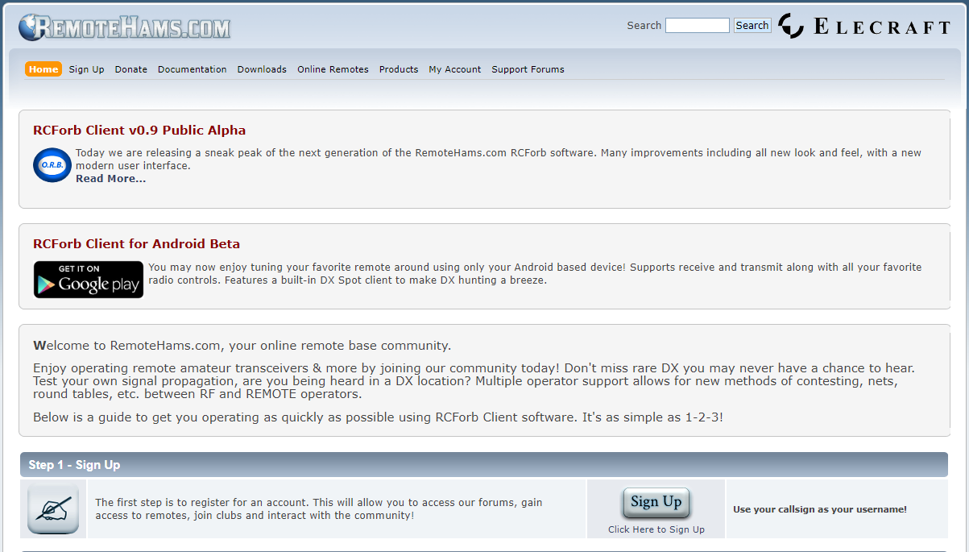
RemoteHams Website
RemoteHams Website

Slide 7
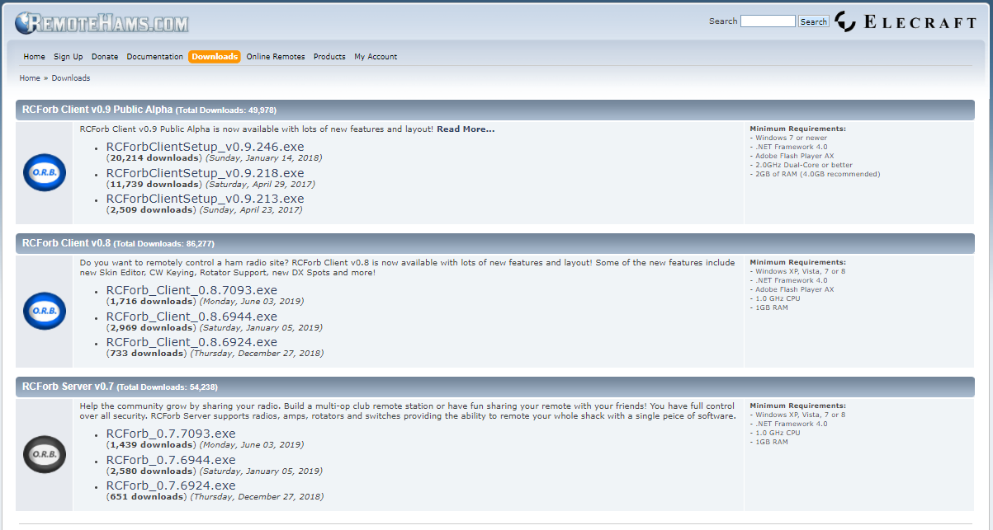
RemoteHams Download Page
Client & Server Downloads

Slide 8
The Original Remote Client
Older Version

Slide 9
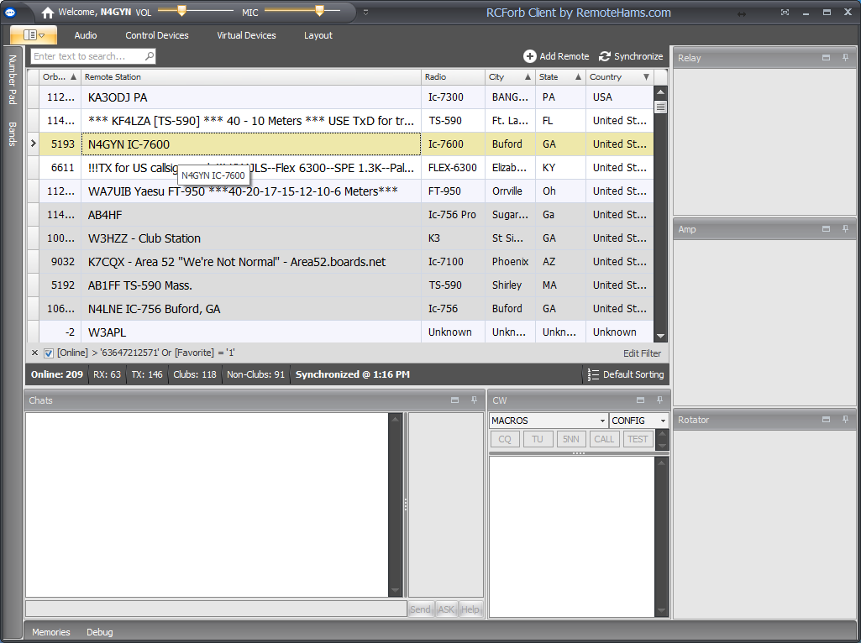
The Latest Client
The “Lobby” in the Newer, Better Client

Slide 10
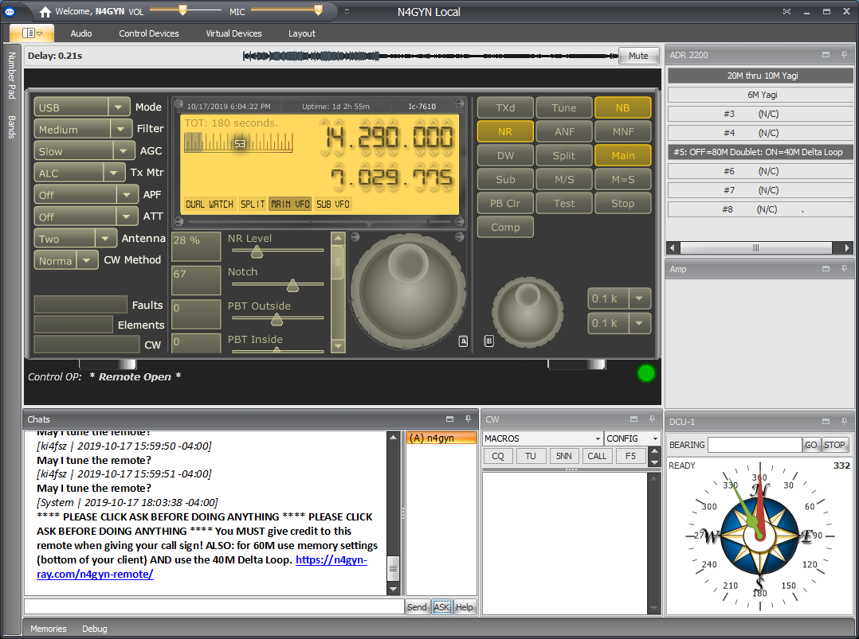
Connected to N4GYN Remote
Connected to my Remote

Slide 11
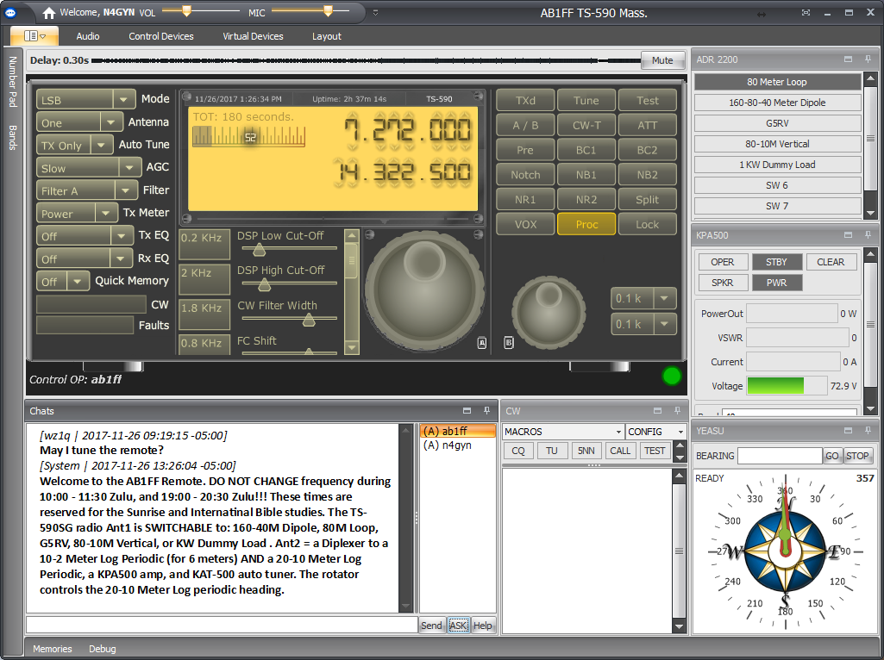
Connected to AB1FF Remote
Connected to AB1FF Remote in Shirley, MA

Slide 12
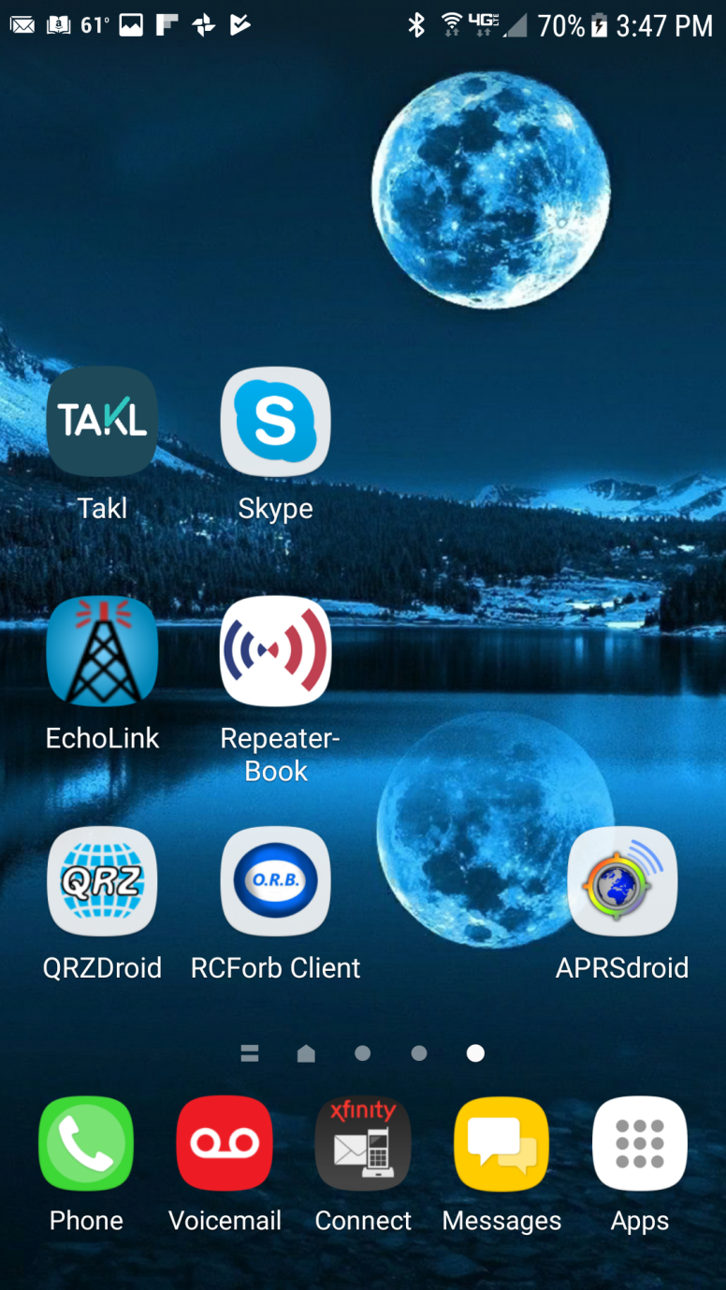
The Mobile App

Slide 13
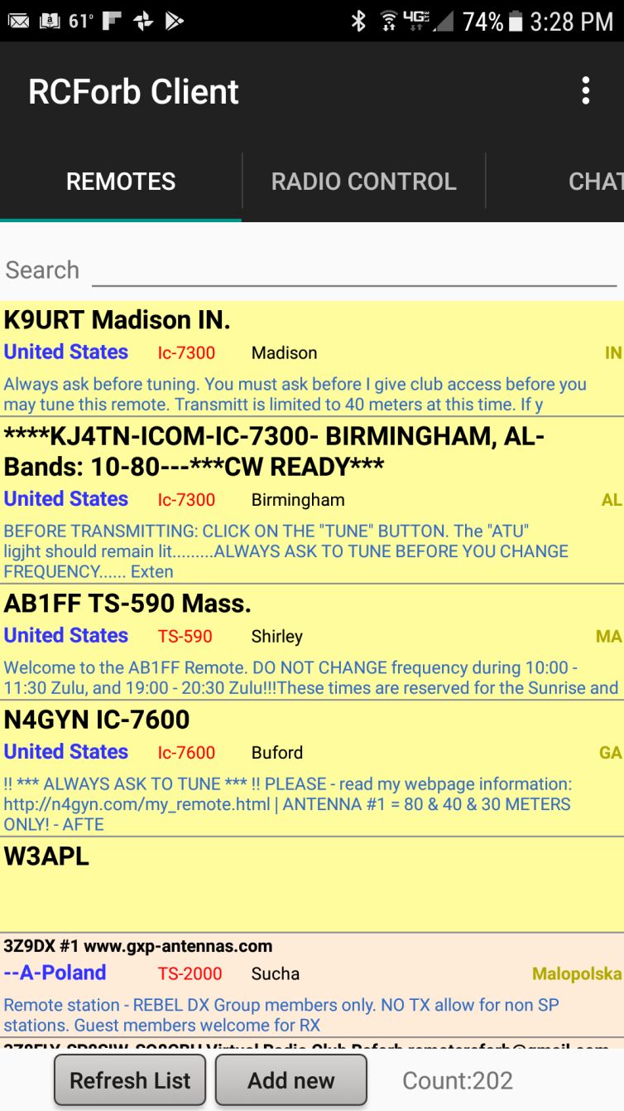
The Lobby Screen (List of Remotes)

Slide 14
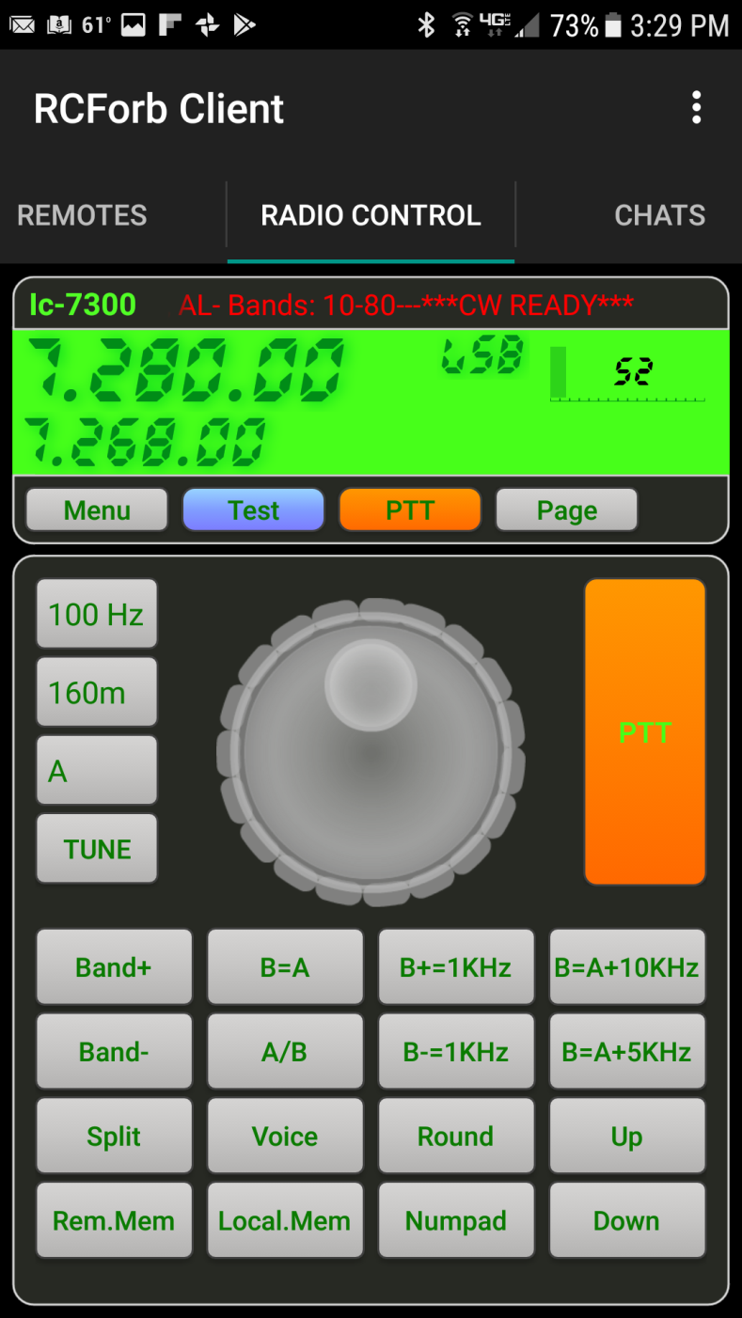
RADIO CONTROL - First Screen After Login

Slide 15
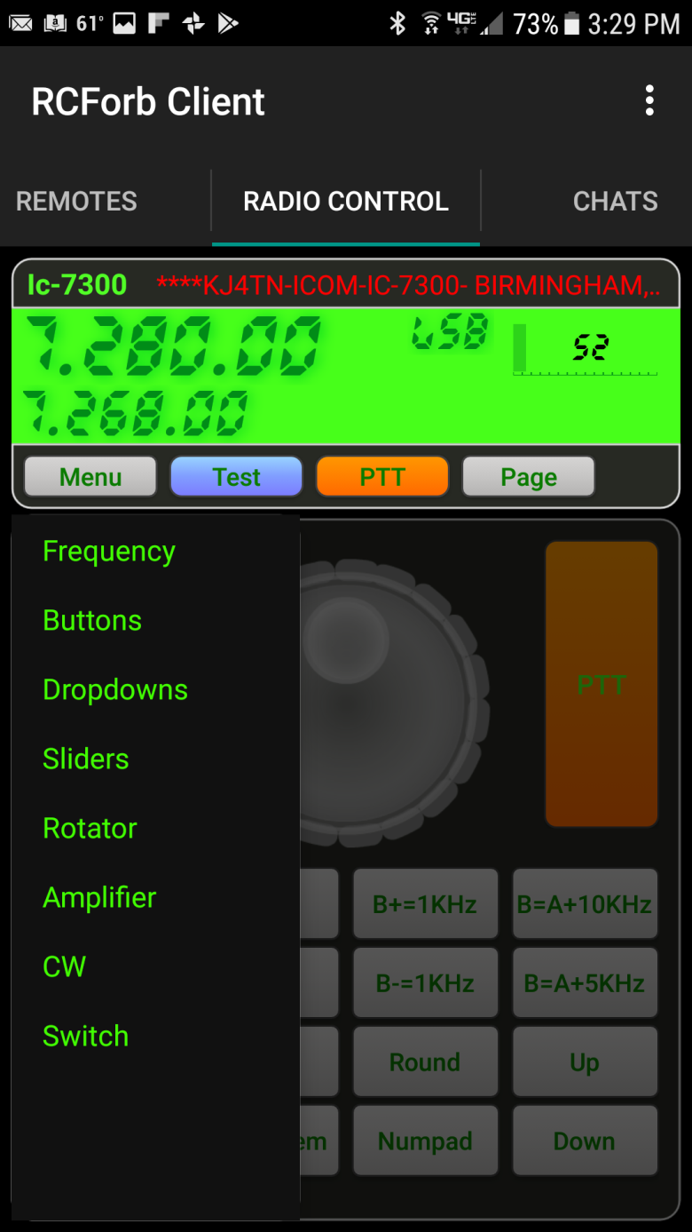
The MENU Screen

Slide 16
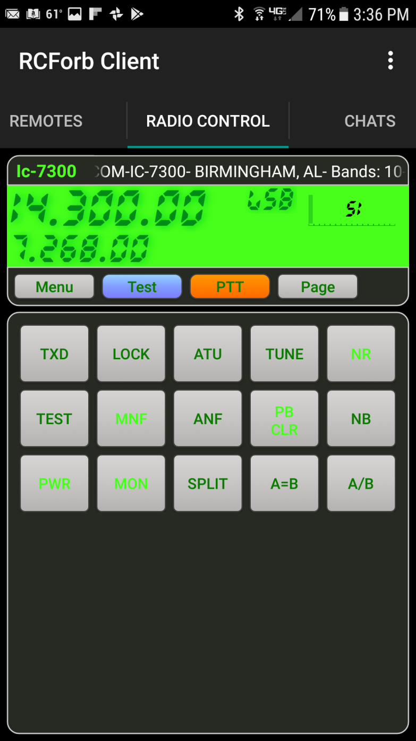
The BUTTONS Page

Slide 17
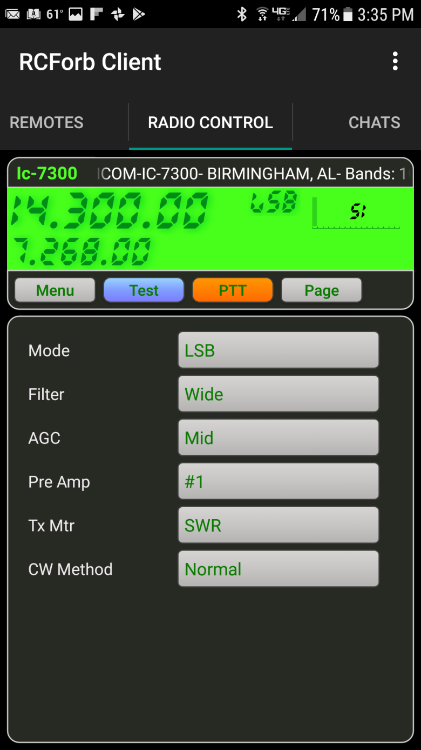
The Drop-Downs Page

Slide 18
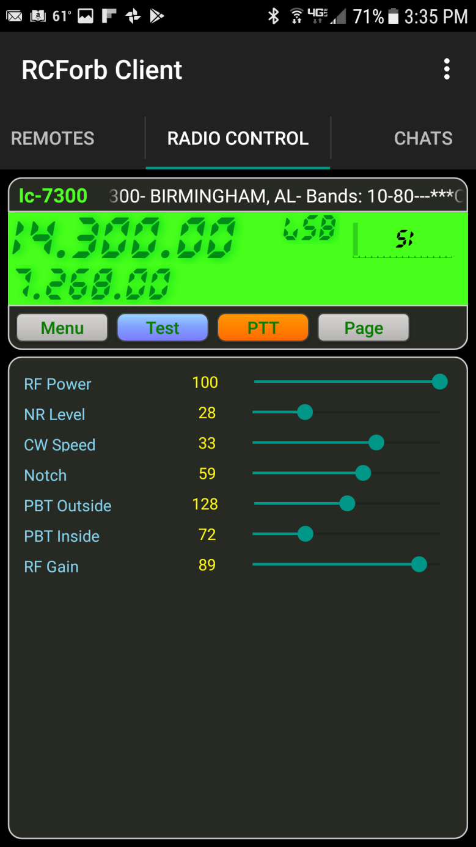
The Sliders Page

Slide 19
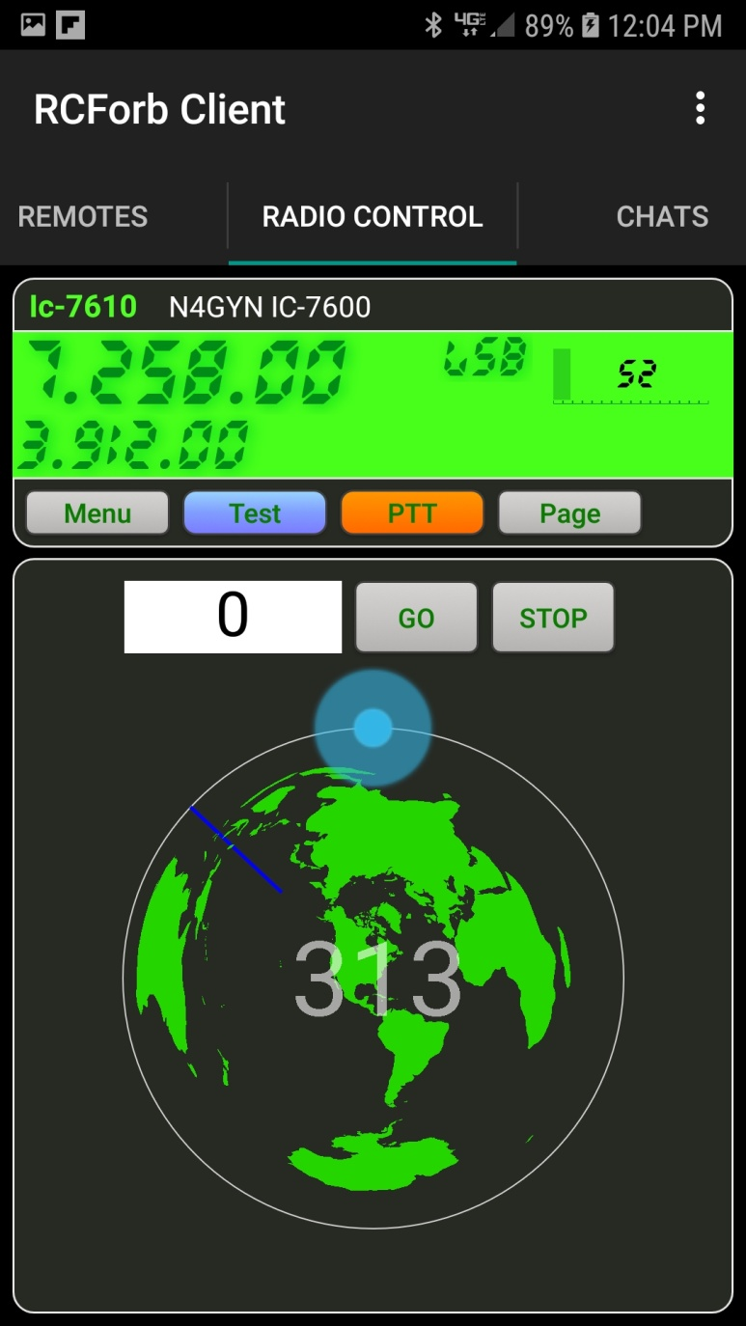
The Rotator Page

Slide 20
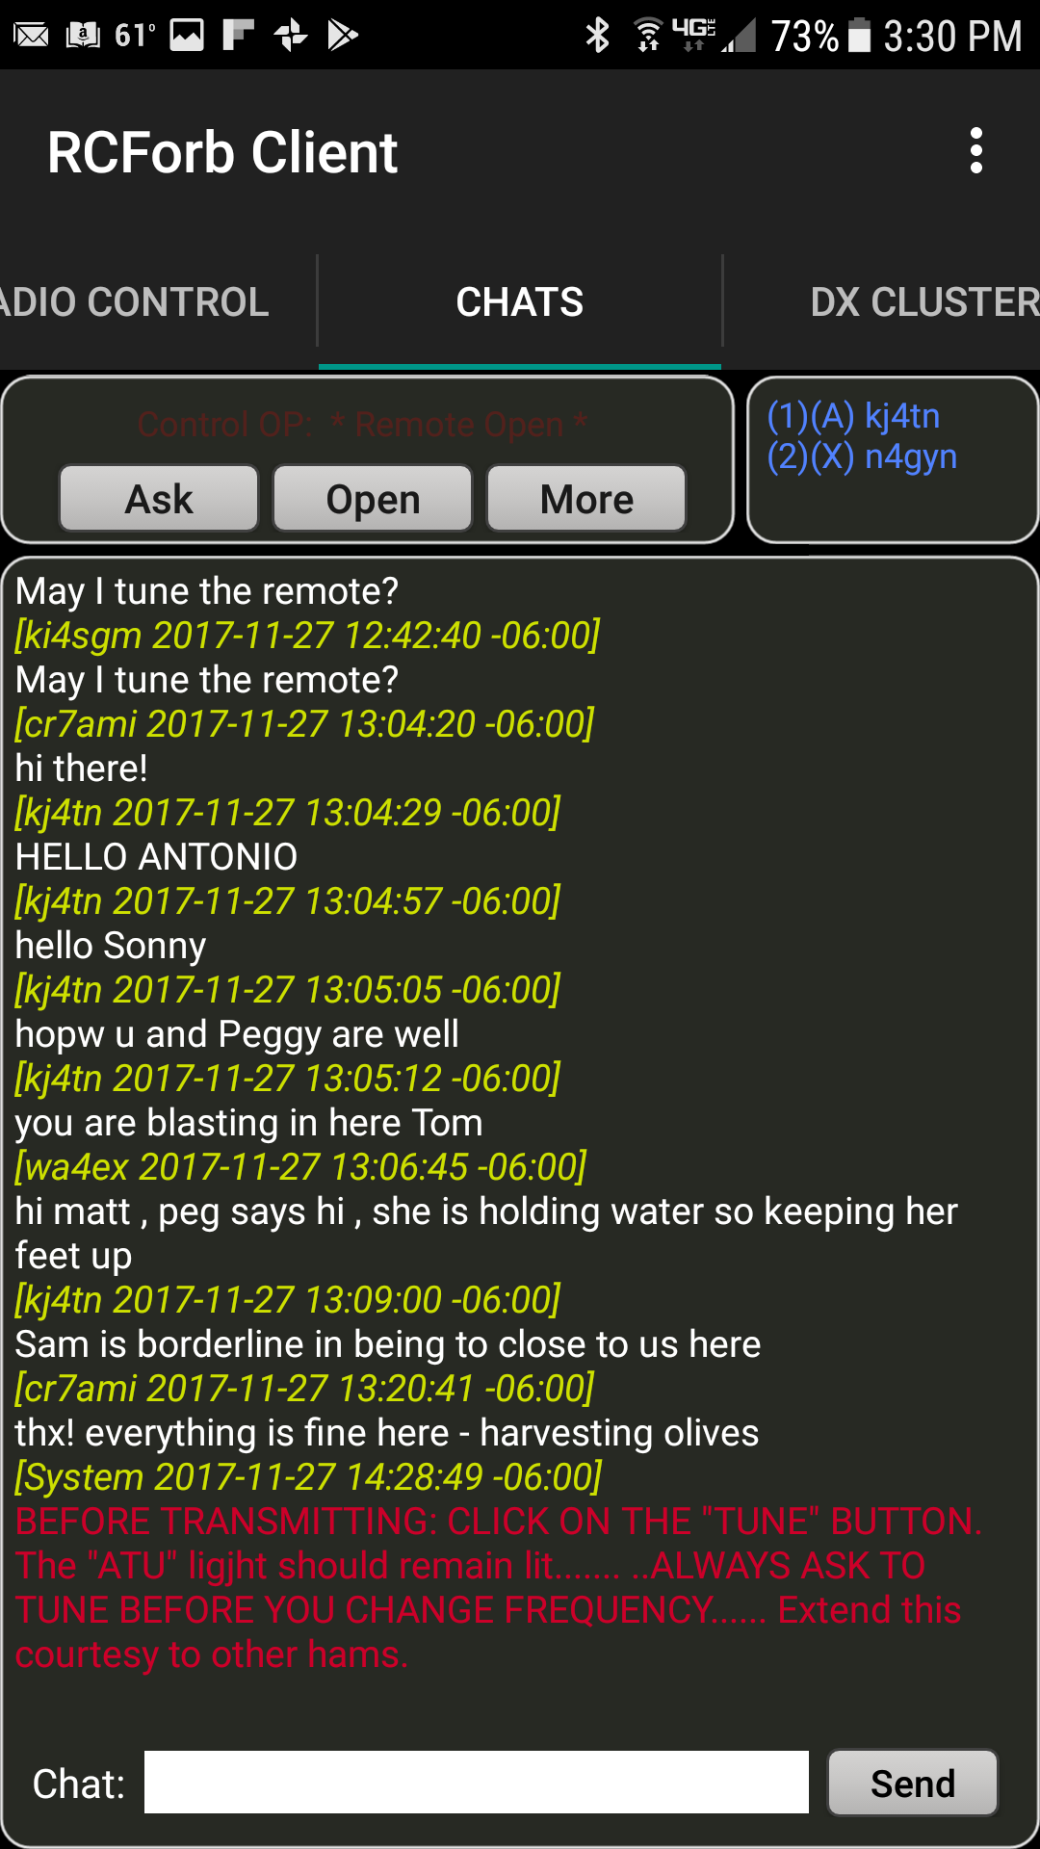
The CHAT Screen

Slide 21
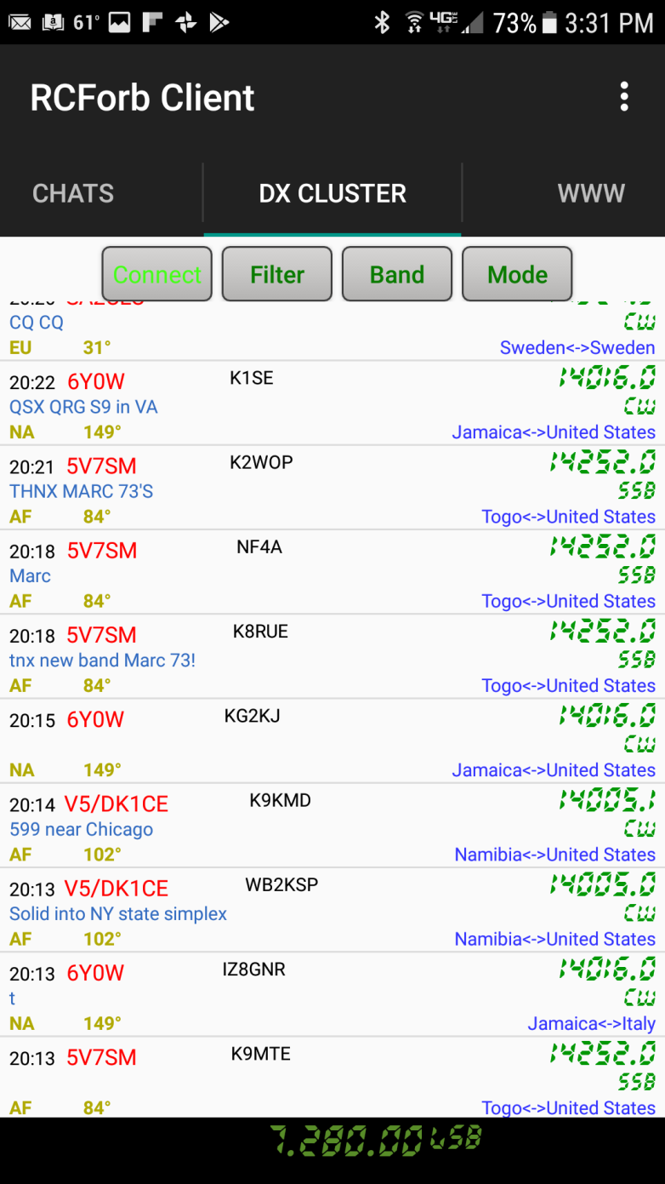
The DX Cluster Screen

Slide 22
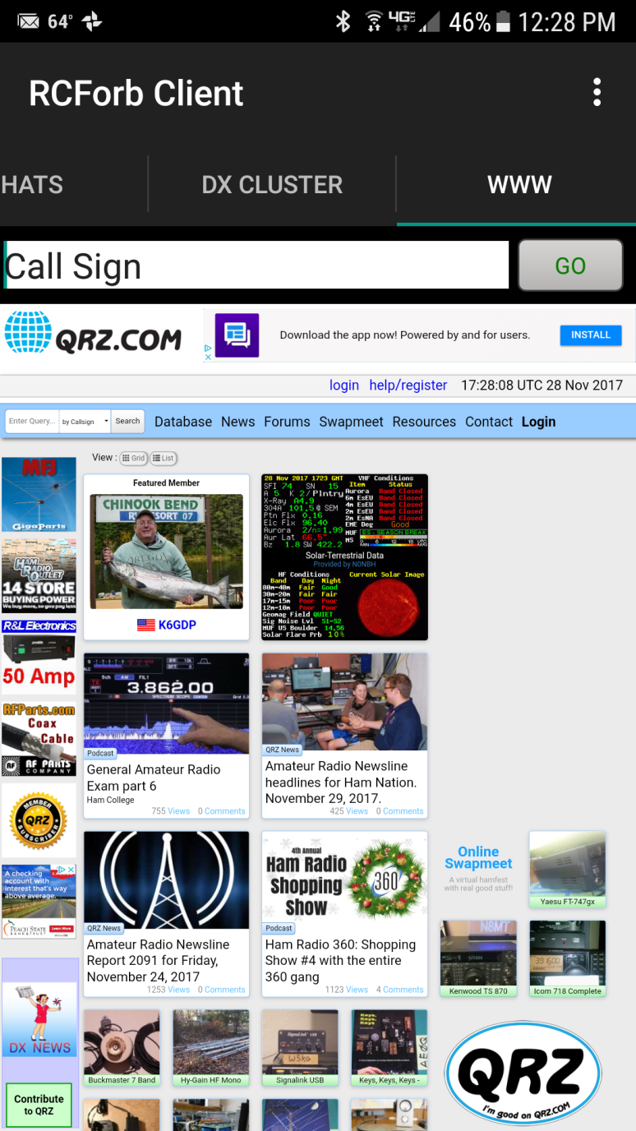
The Embedded Web Browser Screen

Slide 23
RemoteHams.com
Now let’s look at the RCForb Server

Slide 24
RCForb Server
Notes:
This screen shows whenever a user clicks the ASK button and any messages they may type to you or other users.

Slide 25
RCForb Server
Notes:
This is part of the scrolling info you will see when you start up the server. Shows STATUS when connecting with the radio, connecting to the rotator controller, and connecting to the remote antenna switch. It also shows the K3 emulation and the virtual serial port status.

Slide 26
RCForb Server
Notes:
Here is the rest of the info printed during the initialization of the server.

Slide 27
RCForb Server
Notes:
Here is where you can view the activity of the user in detail. This helps you to see if THEY are having problems or if YOUR SERVER is having problems.

Slide 28
RCForb Server
Notes:
This is where you can add/edit memory settings for the user. It is especially useful for using the 60 meter “channels”.

Slide 29
RCForb Server
Notes:
Here’s where you enter your operating info and edit your messages for users to see when they log in.
ALSO: This is where you make your remote visible to others looking for a particular station to use.

Slide 30
RCForb Server
Notes:
This screen shows whenever a user clicks the ASK button and any messages they may type to you or other users.

Slide 31
Disable the Remote

Slide 32
Enable the Remote

Slide 33
Club Manager Icon

Slide 34
Transmit Approval

Slide 36
IP Manager

Slide 37
User Manager

Slide 38
Global Security Manager

Slide 39
Database Manager

Slide 40
RemoteHams.com
Now let’s see it LIVE!
DRUM ROLL PLEASE!

